Slide 1
Analysis of Marijuana Legalization Impact
Project By
Erik Thompson

Slide 2
Motivation and Summary
The legality of recreational marijuana has long been debated. Proponents argue that marijuana is a safer alternative to alcohol with many therapeutic effects and a potential to lower crime rates, while opponents argue that it is just another addictive substance that contributes to crime and drug addiction. In our analysis, we intend to answer the following questions:
Was there a significant increase/decrease in violent crimes in 01/13, when marijuana was legalized in Denver, CO?
Was there a significant increase/decrease in reported drug use over the same period?
As marijuana sales rise and fall, is there a notable correlation between any crime or drug statistics?
We found that crime and drug use generally follow a cycle throughout the year, with a peak in the summer and trough in the winter, while marijuana sales have steadily gone up throughout years. The notable exceptions were with alcohol/alcohol related crimes, disorder charges and assault charges. Alcohol related crimes and DUIs were relatively steady until marijuana was legalized and then slowly dropped at about the same rate marijuana sales grew. The same trend appeared with disorder charges. Assault charges, on the other hand, appeared to grow along with marijuana sales.

Slide 3
Datasets Used
Dataset 1
’Marijuana Sales Revenue in Colorado’
Source: data.colorado.gov
Gives us a history of marijuana sales revenue by county broken up by recreational and medical from 2014+
Dataset 2
‘Raw Crime Data for Denver, Colorado’
Source: data.world
All records of crime in Denver, CO for 2013-2017
Details on crime type, latitude/longitude, county, date/time, details of crime.

Slide 4
Data cleanup
Dataset 1
Remove unwanted columns (geolocation, precinct, incident id, offense id, offense code, offense code extension).
Filter occurrence date to show only 2013-2016 to match other dataset.
Create individual dataframes for each crime type (In retrospect this was a bad idea and a waste of time).
Dataset 2
Combine med/rec columns into one.
Filter data to only show counties within the city of Denver.
Sum all sales by month and sort and group by month and year.

Slide 5
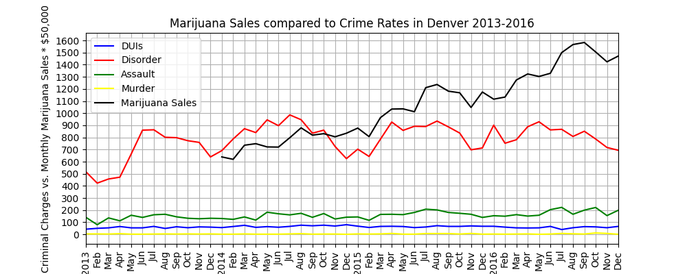
Analysis
First, I plotted the sales data against all of the crime data to see if there were any obvious trends. Nothing jumped out at me.

Slide 6
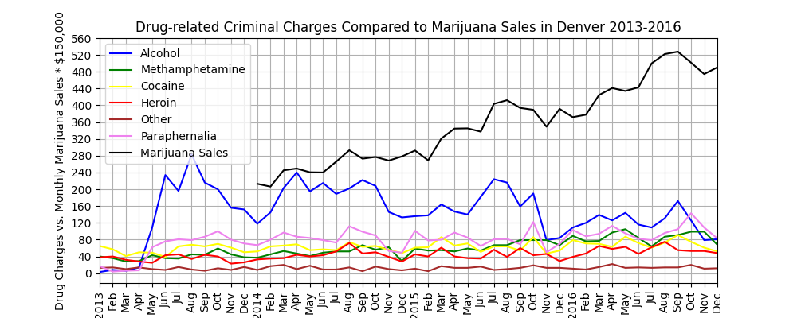
Analysis cont.
Next, I did the same for the drug/alcohol dataframe I created.
Here it was somewhat obvious that there was a correlation between the alcohol statistics and sales data.

Slide 7
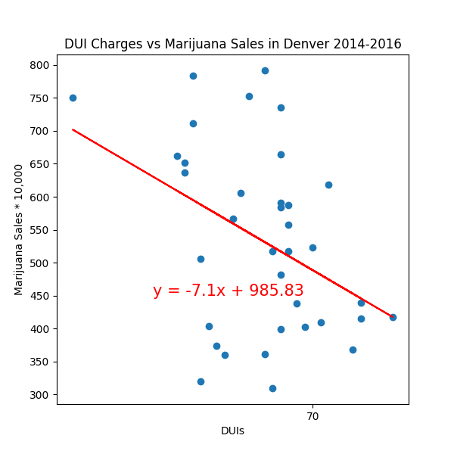
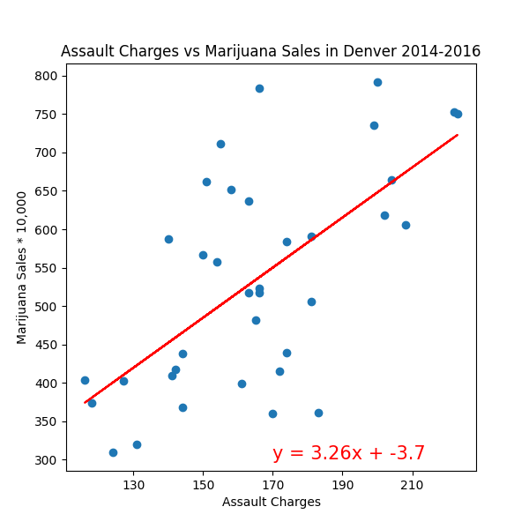
Analysis cont.
Next, I closely examined each individual crime type and drug by creating dotplots and calculating linear regression.

Slide 8
Discussion
The debate continues as to the large-scale effects that marijuana has on our communities. Although we drew several correlations, none of them point to a single conclusion or prove causation. Personally, I expected that trends would go in the same direction, whether up or down. But the downtrend in disorder and uptrend in assaults contradicts that hypothesis.
If I were to look further into this project, I would look at the crime and drug rates in a control city to account for trends throughout the country.

